Slide 1
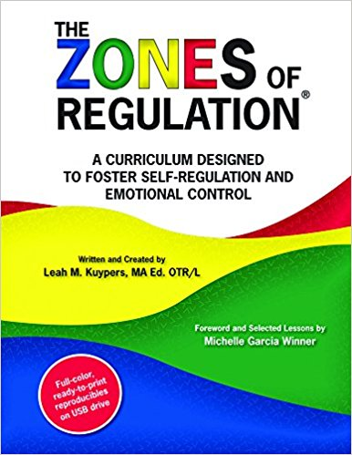

The Zones of Regulation
A curriculum designed to foster self-regulation and emotional control
Created by Leah Kuypers
Kate Armstrong
Speech and Language Therapist

Slide 2
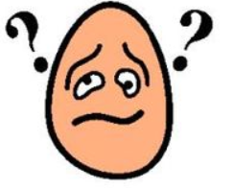

Why teach the Zones?
Need to teach our children good coping and regulation strategies so they can help themselves if they become frustrated, sad, anxious, bored etc….
Geared towards helping children gain skills in consciously regulating their actions which in turn leads to increased control and problem solving abilities
Helps students gain an increased vocabulary of emotional terms, skills in reading facial expressions, insight on events that trigger their behaviours, problem solving skills etc….

Slide 3

Name it!
To build emotional vocabulary
To develop awareness of feelings
To normalise feelings
To build empathy
To find coping strategies
I can see you are nervous about your first day at school….
I can hear that you are frustrated by your maths…

Slide 4
Reading emotions
Voice:
Eyebrows:
Eyes:
What does the feeling look like?
Nose:
Mouth:
Body language

Slide 5
Explaining feelings
I
feel
because…

Slide 6
Emotions vocabulary
Explain new feelings words
Match them to easier words/faces
Point them out as they come up

Slide 7
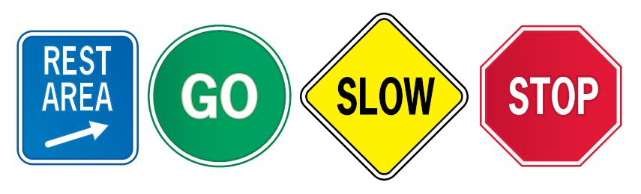
What are the Zones?
BLUE Zone- used to describe low states of alertness and down feelings. Your body is moving slowly or sluggishly. Feeling sad, tired, sick, bored, hurt etc…
GREEN Zone- used to describe a calm state of alertness. Your body is alert and ‘good to go’. Feeling happy, calm, content, focused, ok etc…
YELLOW Zone- used to describe a heightened state of alertness with elevated emotions and starting to lose some control. Feeling frustrated, nervous, confusion, stress, silliness, ‘the wiggles’ etc…..
RED Zone- used to describe an extremely heightened state of alertness with very intense emotions. You are not in control of your body. Feeling rage, panic, terror, devastation, anxious, extremely silly etc….

Slide 8
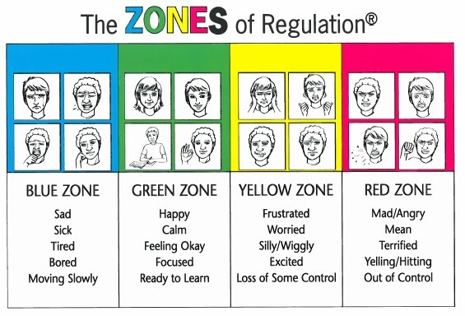
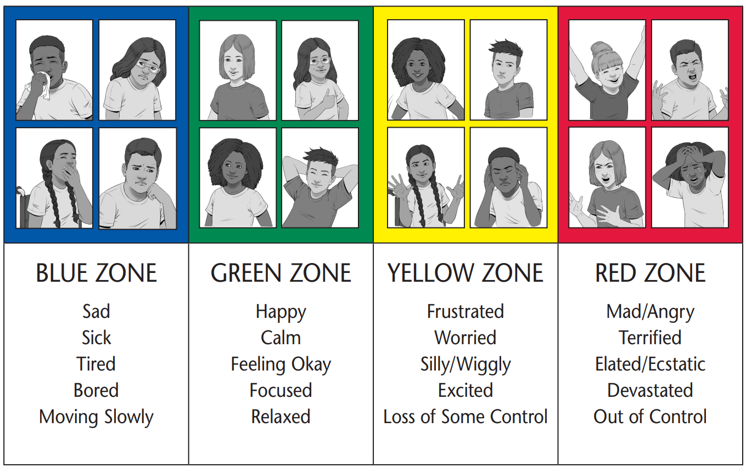

Slide 9
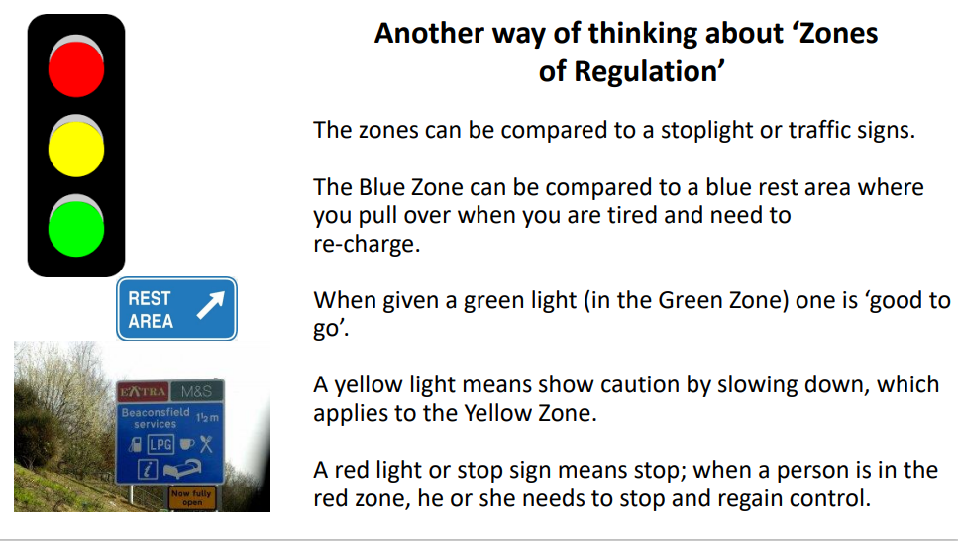
Stop, Slow, Go

Slide 10
Goals of the Zones?
To teach the children:
To identify their feelings and level of alertness
Effective regulation tools
When and how to use the tools
Problem solve positive solutions
Understand how their behaviours influence others thoughts and feelings
INDEPENDENT REGULATION

Slide 11

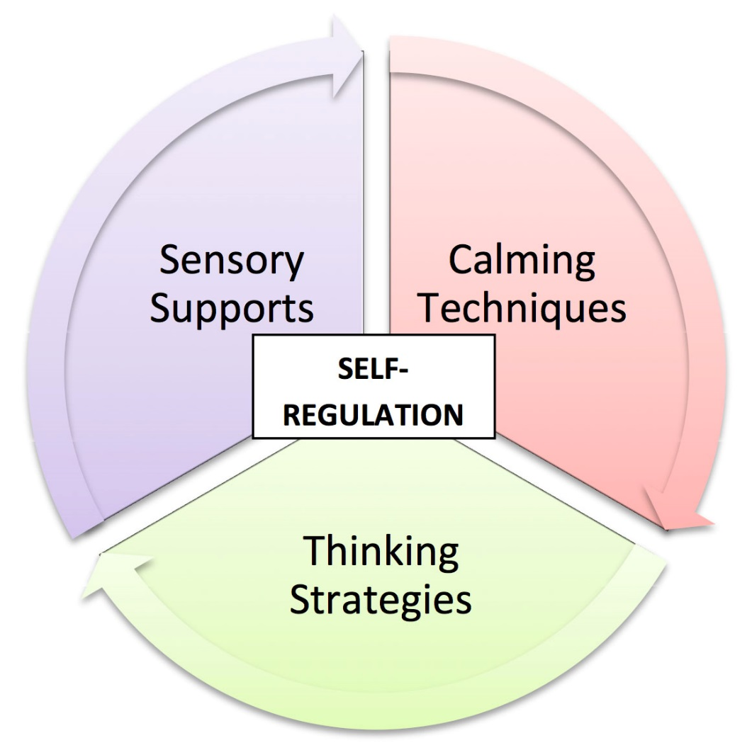
Tools for Self-Regulation
Sensory support
Will depend on the sensory supports and equipment available
Calming techniques
Breathing exercises
Count to 10
Thinking strategies
Big vs Little Problem

Slide 12
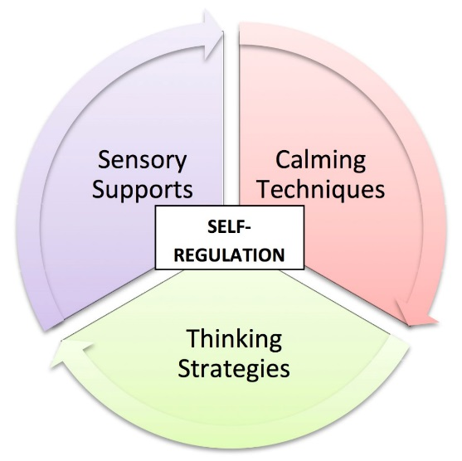
Sensory support
Will depend on the sensory supports and equipment available

Slide 13
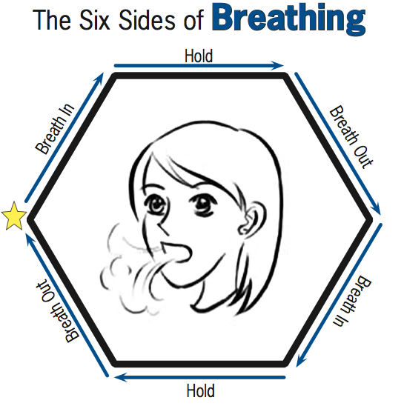
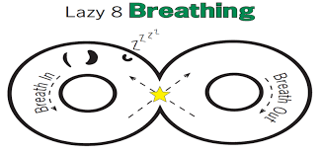
Calming techniques
6 sides of breathing
Lazy 8 breathing
Calming sequence
Count to 10
Deep breaths
810 × 388Images may be subject to copyright. Find out more

Slide 14
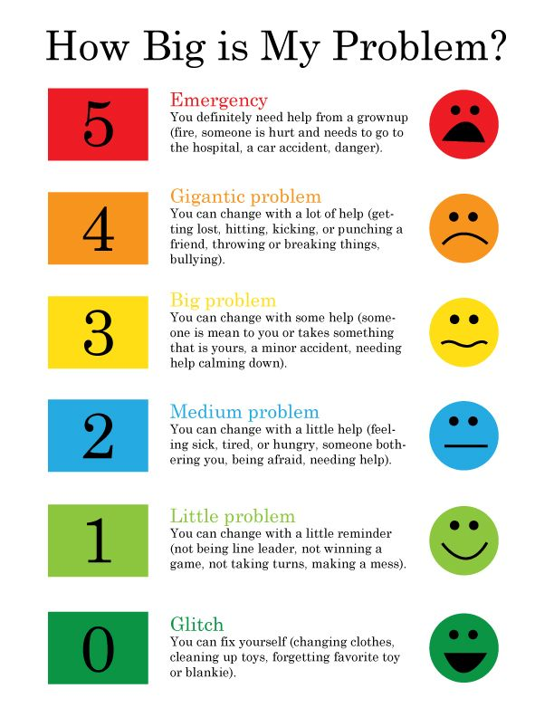
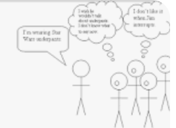
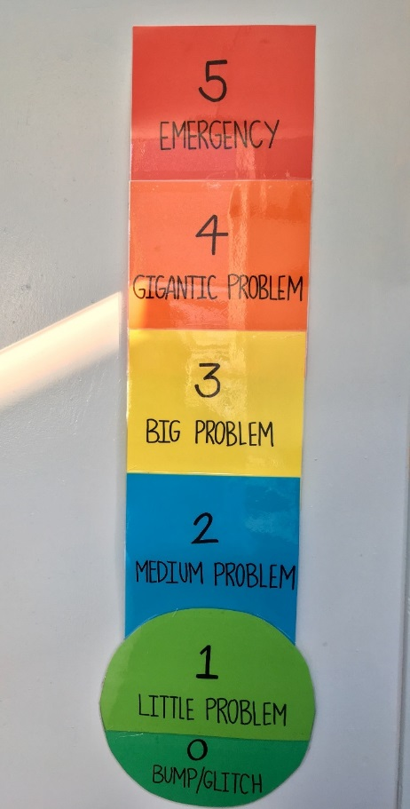
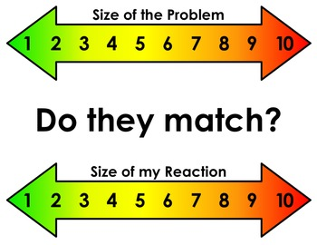
Thinking strategies
Big vs Little Problem
Comic Strip Conversations

Slide 15
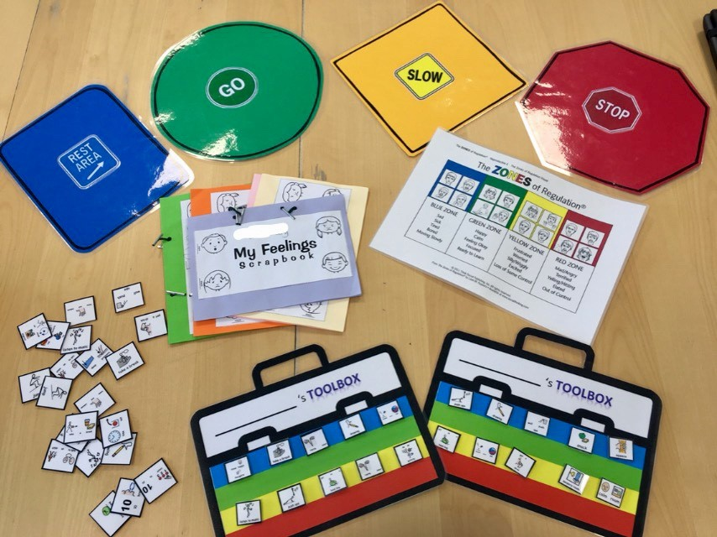
Notes:
]

Slide 16
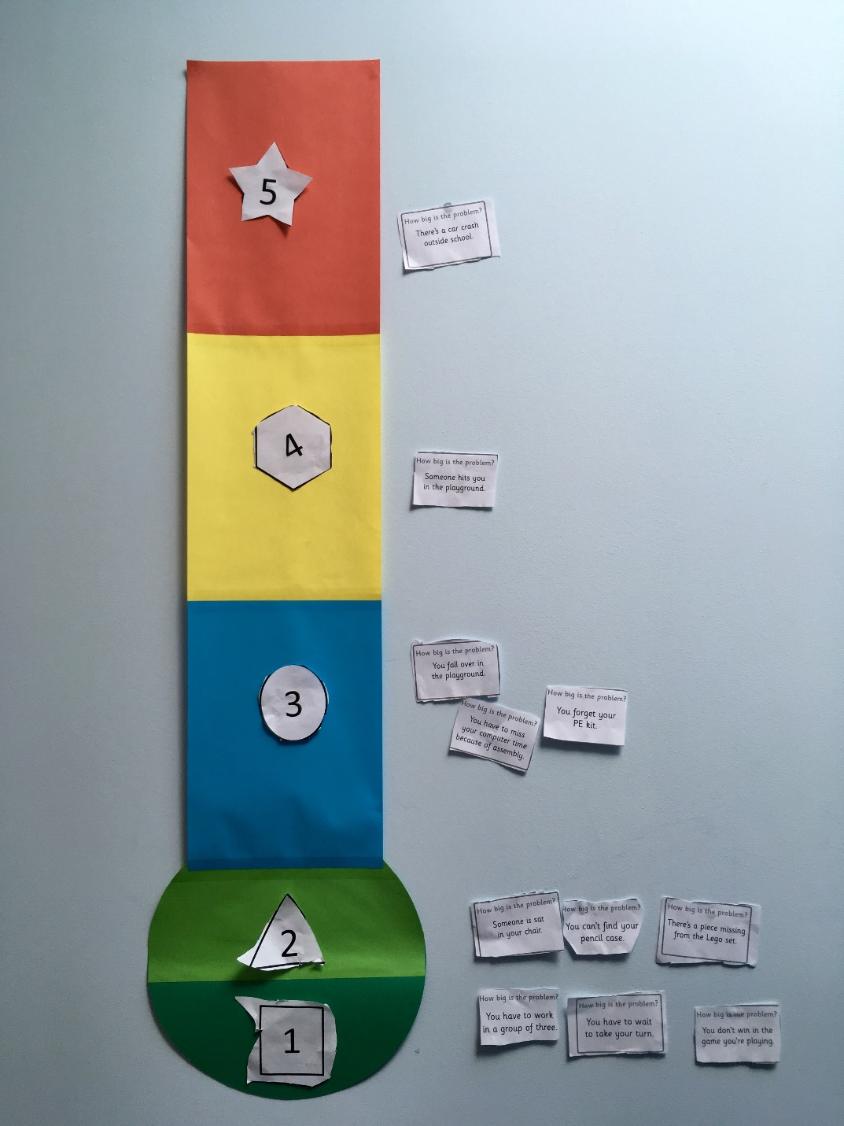
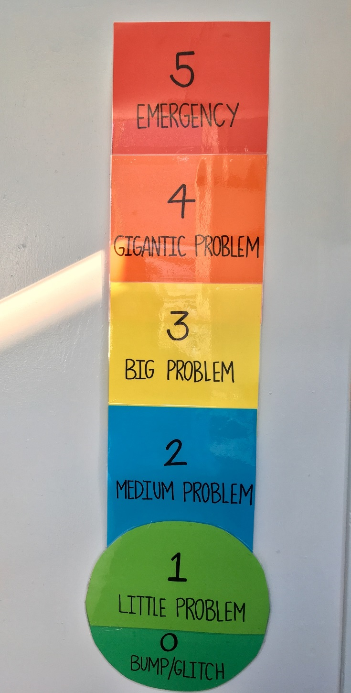
Notes:
]

Slide 17
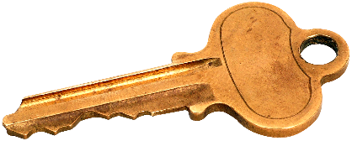

Key points
Name it to tame it! Label feelings
Develop emotional language skills
Use Zones to check in with feelings
Make a toolbox of personal strategies

