Slide 1
Parent Workshop Reading at Home
Jane Brown - April 2023

Slide 2
Today’s Aims:
To help you understand the number and colour system
To help you to understand the reading codes
Top tips to help support reading at home

Slide 3
Why should I read with my child at home?
“The more that you read, the more things you will know. The more that you learn, the more places you’ll go.“ (Dr Seuss, I Can Read with My Eyes Shut!)
Reading is a fundamental life skill. It is the key to success.
Once we learn to read, we can read to learn.
Reading at home is essential. The more a child can read themselves, and listen to books being read, the more confident they will become; the better they will make connections with themselves and the wider world and enjoy the adventure and pleasure that books can bring.

Slide 4
(Jane Brown)
The Number and Colour System
National Book Banding | TPS Colour | Number
Pink | Red | 1
Red | Yellow | 1/2
Yellow | Dark Blue | 2/3
Blue | Pink | 3
Green | Brown | 3/5
Orange | Green | 5
Turquoise | Grey | 5/6
Purple | Orange | 5/6
Gold | Black | 6
White | Cream
Lime | Purple
Brown | Light Blue
Grey/Dark Blue | Free Reader

Slide 5
Reading Codes
I | I can read this by myself
U | Please ask me questions so that you know I have understood what I have been reading about
S | Please help me to sound words out in this book
T | Please read this book to me
D | Please ask me questions to be a detective and work out more difficult questions

Slide 6
Independent Reading
A high level skill
It means reading and understanding
Our students should only read completely independently if they have acquired this skill
Occasionally a student may choose a book that is at a much lower level to enable them to do this

Slide 7
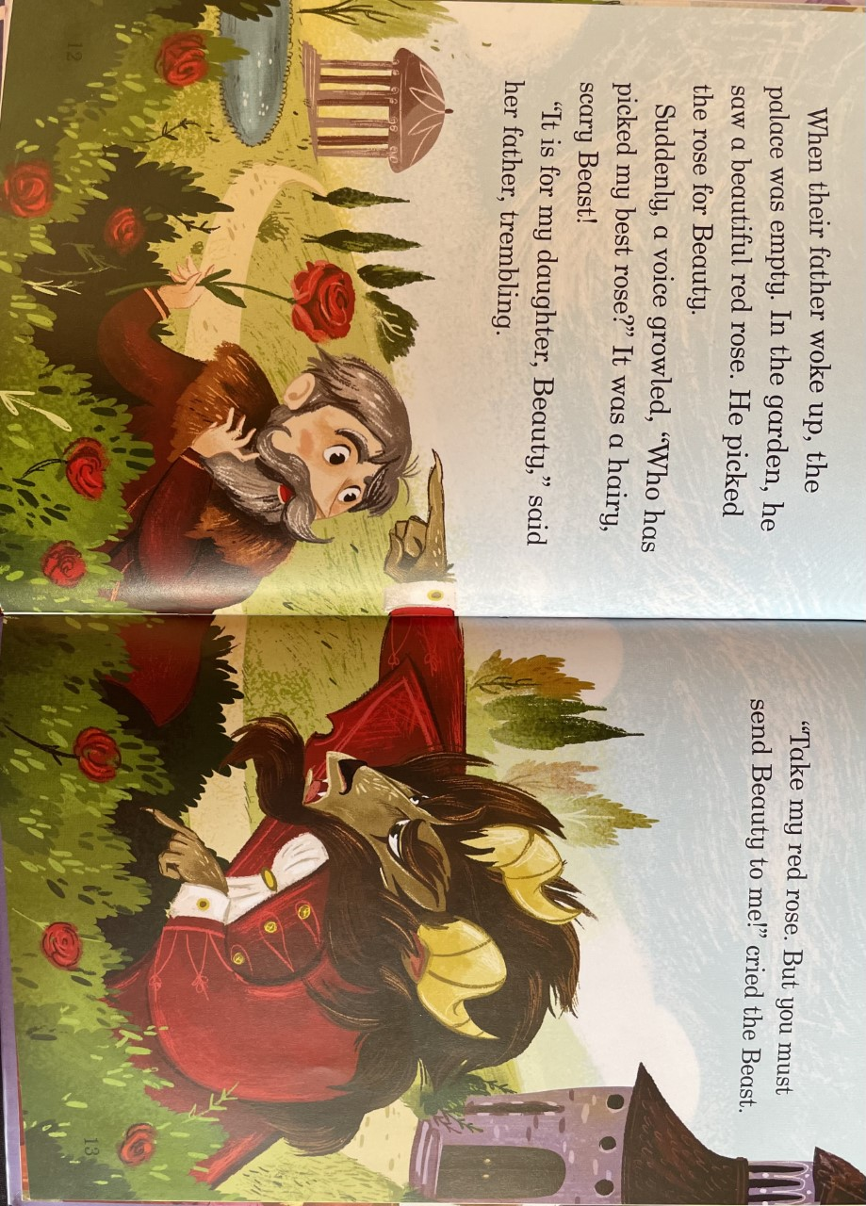
Understanding their Reading
There is no point reading unless you understand it!
To show understanding we must ask questions:
What questions could we ask about this page?

Slide 8
What?
When?
Where?
How?
Why?
Who?
Relationships … events … objects …
Before … after
Give Evidence
For even more excitement - use the story dice!

Slide 10
Sounding Out
Usually a number book
Help your child to use their phonics to help them to sound out. This includes all of the digraphs that they will have learned in school:

Slide 11
Phase three sounds

Slide 12
Phase five sounds – alternative graphemes

Slide 13
Detective Skills - Inference
Inference skills are more complex comprehension skills.
Inference means filling in what is not written on the page or working out what the author is trying to tell you, using clues and evidence from the text, when it is not explicitly written. Beyond the literal. Reading between the lines.

Slide 14
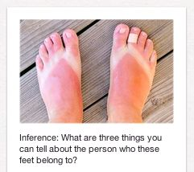

Slide 16
Boom! Fizz! Another one exploded over the children’s heads as they grinned and yelled in excitement.
What can you infer from this writing?

Slide 17
Will sighed and clicked the mouse again. It still wasn’t working. Then suddenly the screen went black. “Oh no!” wailed Will. “It’s all gone! I haven’t got time to start again!”
What was Will trying to get to work? How do you know?
How did Will feel when the screen went black?
How long do you think Will had been sitting there?
What might Will have been doing before this happened?

Slide 18
Example inference questions
What is the weather like if it says the clouds were grey and angry?
What time of day is it if the author says the sun peaked over the mountain?
How is this character feeling if their heart is racing and they are breathless? When have you felt that way?
How is the character feeling if their lip is trembling and their eyes are filling with water?
How old do you think the character is if the author says their knees creaked as they stood reaching for their walking stick?

Slide 19
Reading to Your Child
Huge benefits at any age!
Expand vocabulary and language
Check comprehension
Learn about themselves and the world around them
Inference/prediction skills
Relaxing/ develops relationships
“Regularly reading to a child for the love of it provides a connection between parent and child and helps build strong family ties. Families who enjoy reading together have more opportunities for discussion, developing empathy and attachment.” (NLT)

Slide 20
What if my child refuses to read?
Ensure it’s part of a routine
Create a comfortable and relaxed environment
Read a page/line each
Set a time or page limit
Give lots of praise
Read whatever they want to read – it doesn’t have to be their school book – negotiate!
Encourage activities that require reading eg cooking recipes, reading menus, reading game instructions, internet research
Read to them or listen to an audio book together
Email your child’s English teacher so we can work together

Slide 21
Thank You
Enjoy Reading!
Jane Brown April 2023

